Slide 1
Data Driven Inverse Kinematics of Soft Robots using Local Models
Fredrik Holsten, Morten Pol Engell-Nørregård, Sune Darkner, Kenny Erleben

Slide 2
Motivation
The Challenge
Difficult to get good digital models of home made kitchen table soft robots
Obvious Reality gab
Imperfection in manufacturing
Poor manufacturing skills
Lack of knowledge of material models and parameters
Too simple models
Our Approach
Get direct data of robot regardless of how poorly it is manufactured
Make models based directly on the acquired data
Use many smaller local models instead of one global model

Slide 3
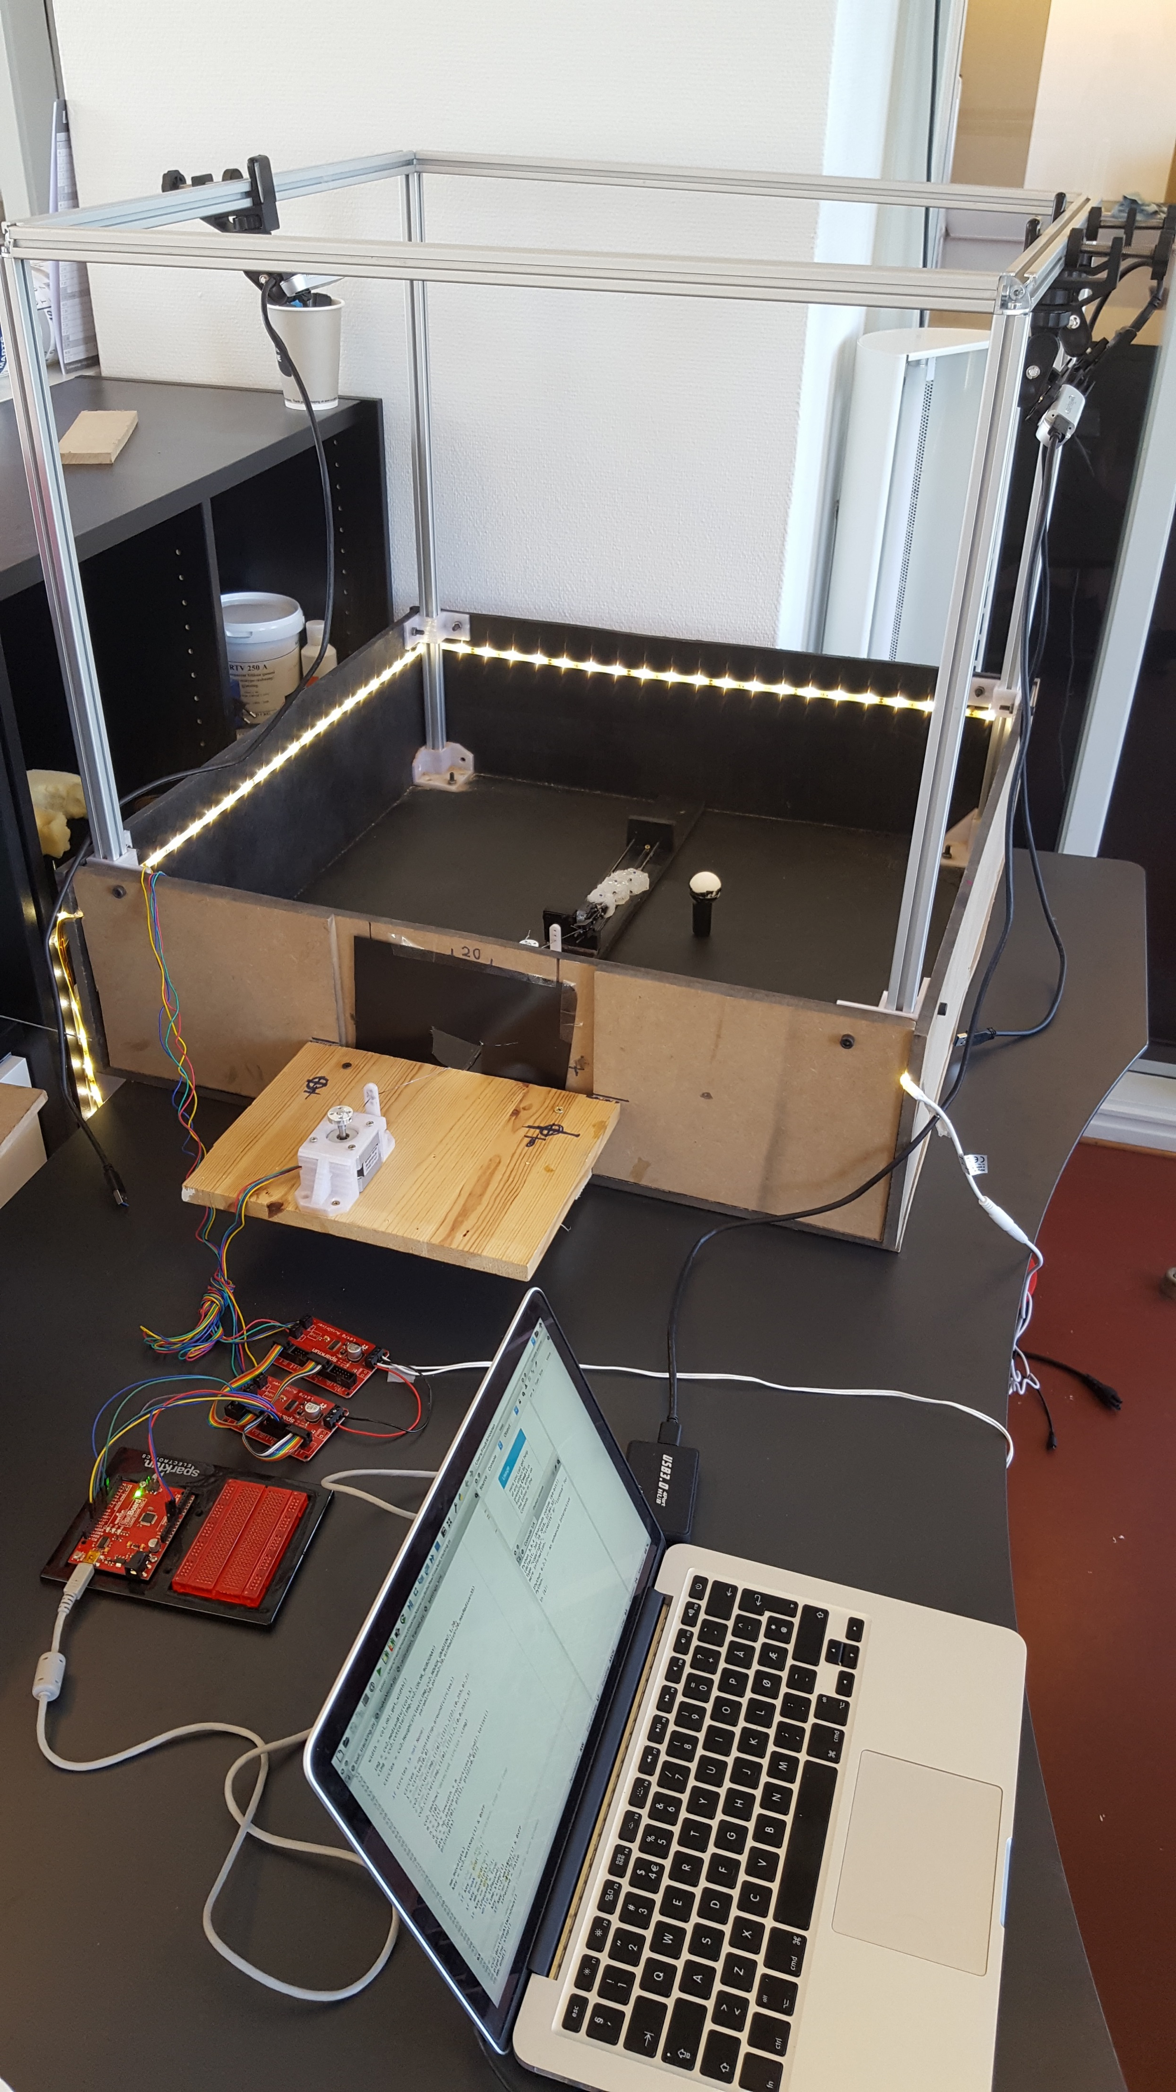
The Learning Cube
RGB-D sensor
RGB-D sensor
Alu-frame
LED-lights
(uniform light conditions)
High precision stepper motors
Robot
Wood box
(black diffuse paint)
Drivers
Arduino
Bring your own device policy
(USB 3.0)

Slide 4
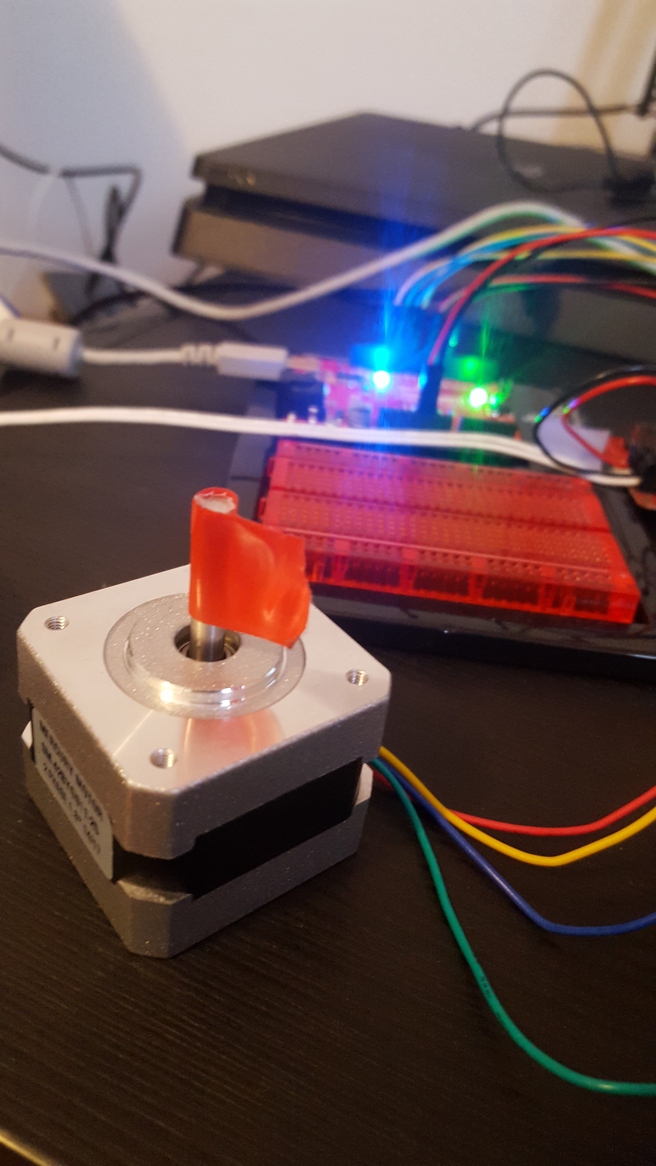
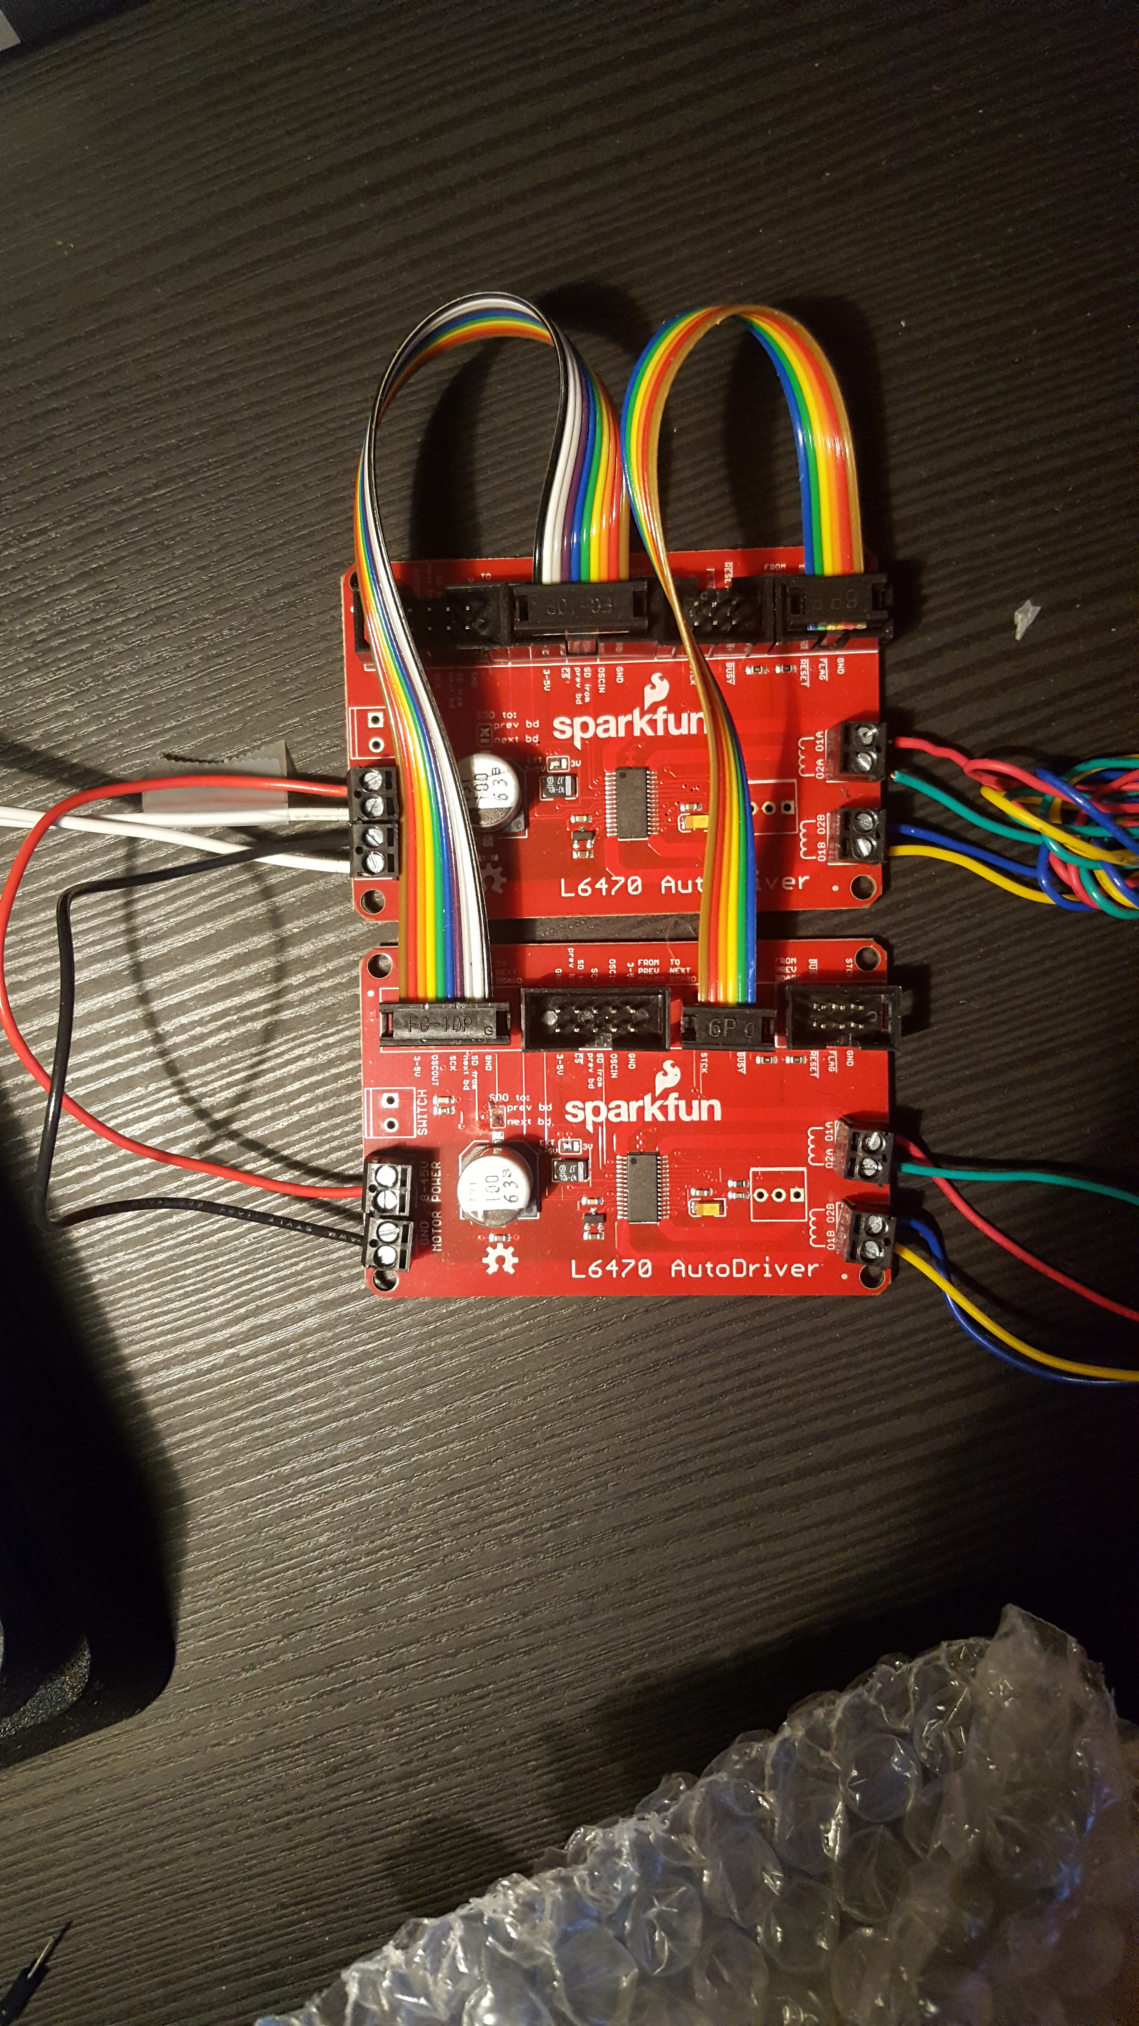
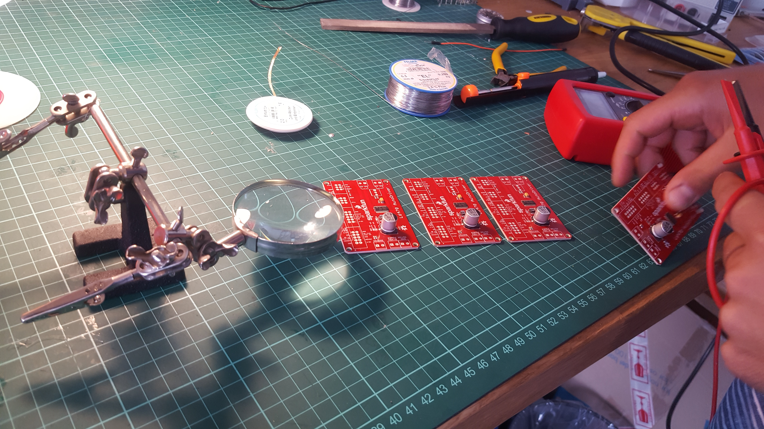
The Actuators

Slide 5
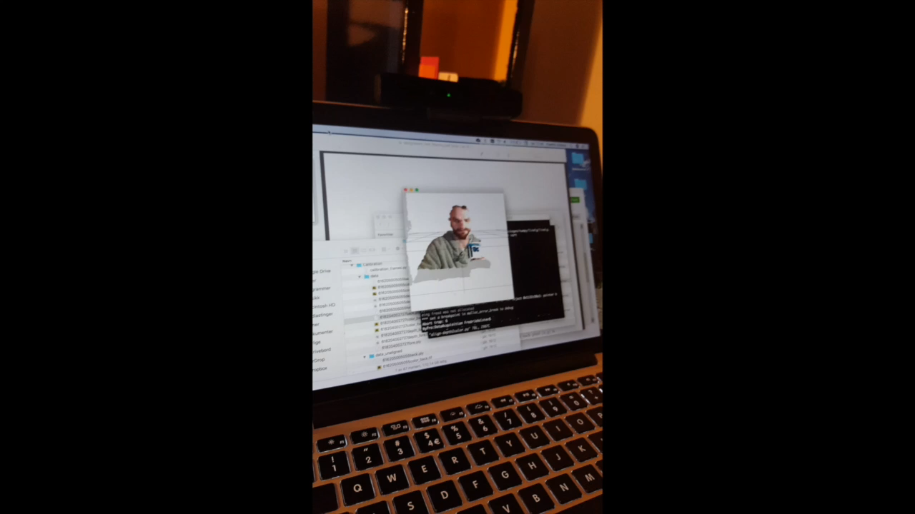
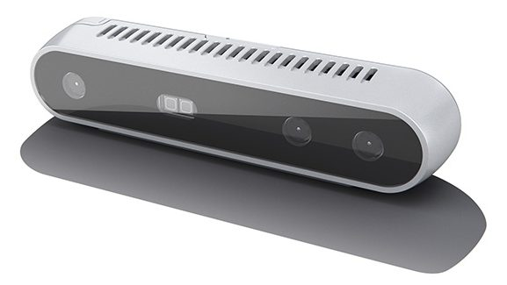
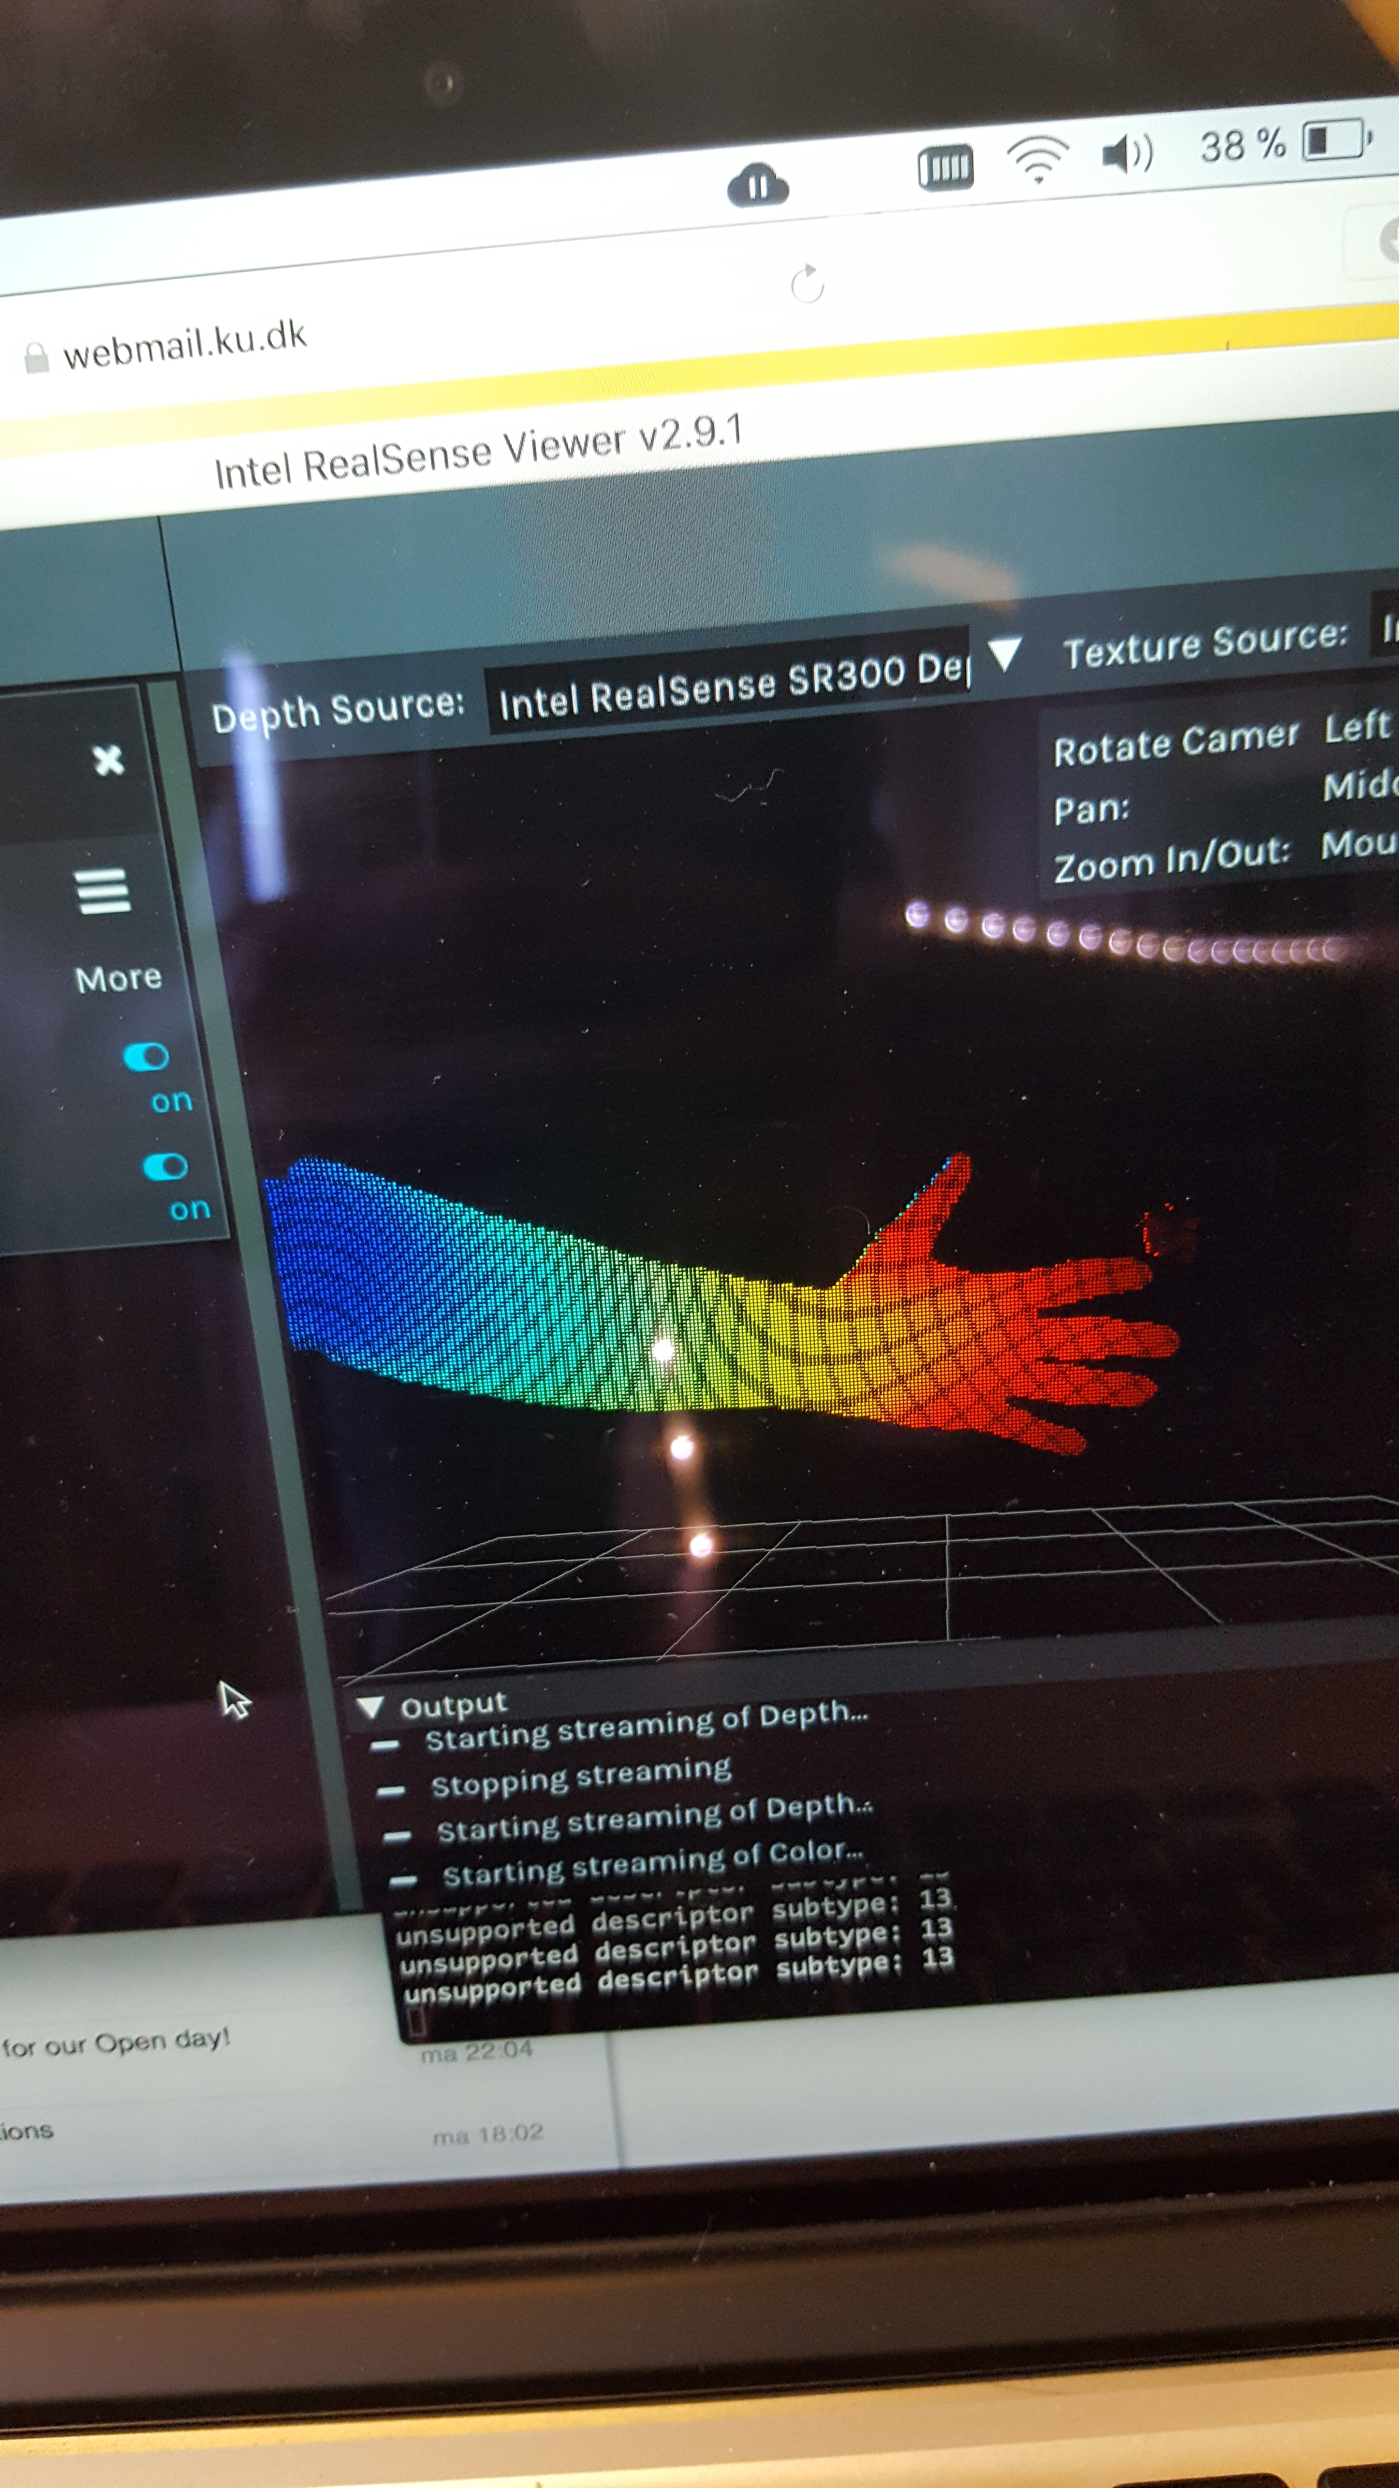
The Sensors

Slide 6
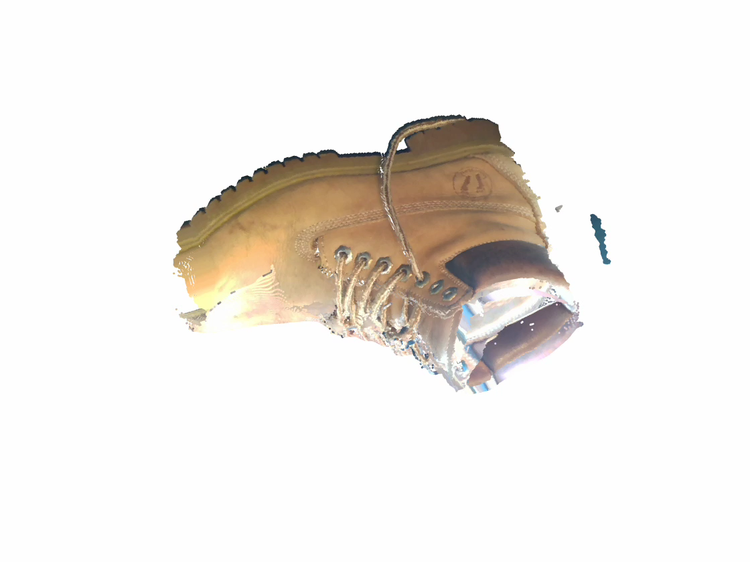
A Complete Reconstruction from Multiple Views

Slide 7
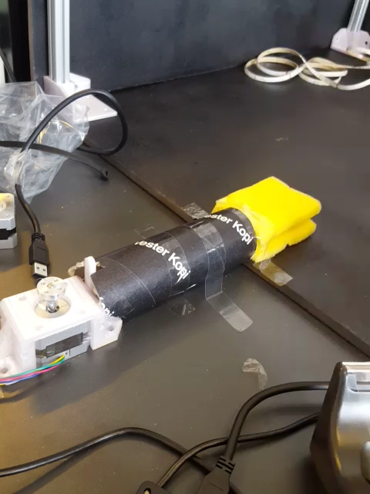
Bringing it all together
A moving sponge...
RGB-D sensor
RGB-D sensor
Alu-frame
LED-lights
(uniform light conditions)
High precision stepper motors
Robot
Wood box
(black diffuse paint)
Drivers
Arduino
Bring your own device policy
(USB 3.0)

Slide 8
Data Acquisition

Slide 9
Data Acquisition
Configuration vector |  |  |  | Shape Vector

Slide 10
Data Acquisition
Configuration vector |  |  |  | Shape Vector

Slide 11
Data Acquisition
Configuration vector |  |  |  | Shape Vector

Slide 12
The Shape function

Slide 13
The Inverse Kinematics Problem
Find optimal configuration such that:
Case 1: Linear in configuration parameters
Solve as QP problem
Do not have to compute monomials
Case 2: Nonlinear in configuration parameters
Numerical methods
Recompute monomials in each iteration

Slide 14
Local Models
Partition configuration space and Train one model on each region

Slide 15
Local Models
Reduce the order of the polynomial regression
Fewer monomials -> Faster optimization
Smaller weight matrix -> Less memory
Fewer unknowns -> Need less equations
Required number of data points:
Cheaper to increase number of local models than order!
12 actuators, 1 8th ordered model
need 125000 samples
3 sec/sample -> 4 days
12 actuators, 40 2nd ordered models
need 3600 samples
3 sec/sample -> 3hrs

Slide 16

Model Selection: IK
Minimum Deviation
Regression Tree
Accuracy
Speed

Slide 17
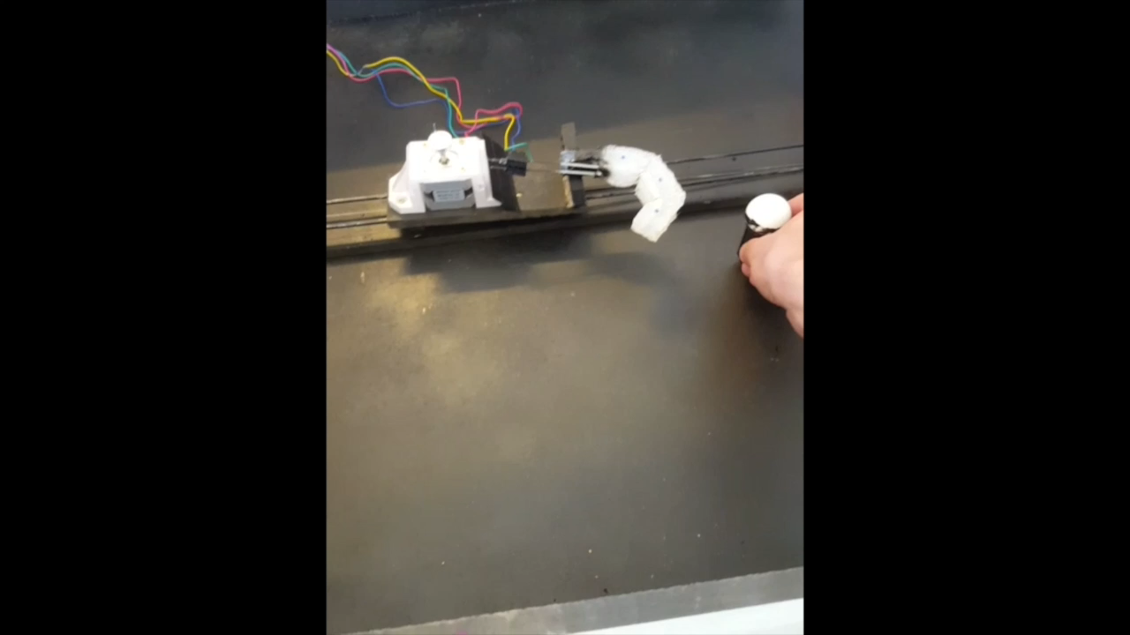
Robot Finger Example

Slide 18
Results
Minimum deviation
Regression tree
5-fold cross validation on optimal number of local models and model order

Slide 19
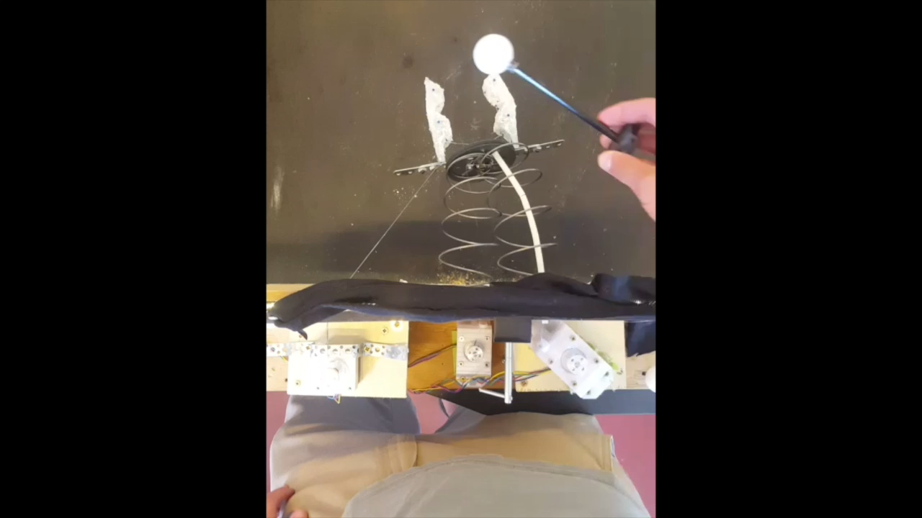
Visual Validation
Real time Ball Tracking
Minimize distance between phantom point and centre of ball
Naive path: Considers only start and goal position

Slide 20
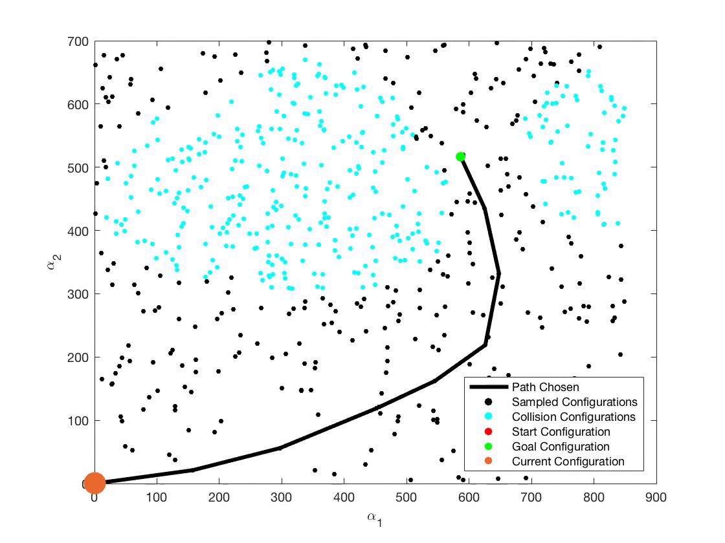
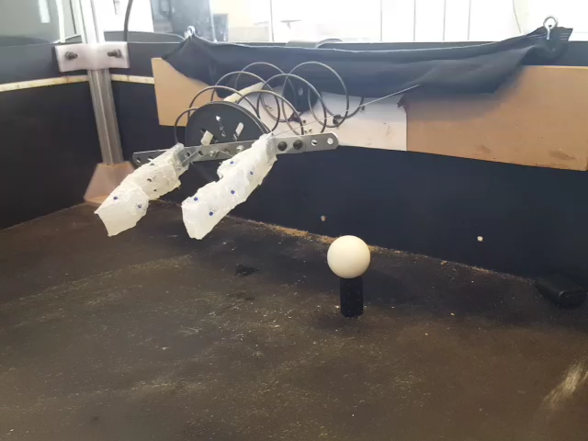
More Intelligent Motion Path Planning
Probabilistic Road Map
Use visual markers to infer which configuration lead to collision
Use phantom marker to find goal configuration
Least cost path though weighted graph

Slide 21
Conclusions and Main Findings
We designed an In-expensive platform for training and interacting with soft robots
We presented an agile method for learning the control of soft robots
Using multiple local models results in Increased learning ability while keeping time and memory complexity as well as required data quantity to a minimum
We validated the inverse kinematics model by visual inspection and validation data sets.

